Slide 1
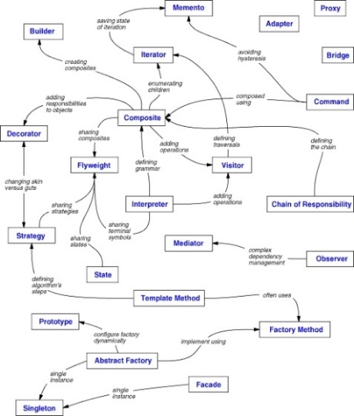
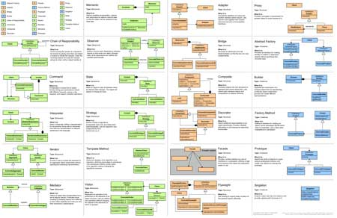
Introduction to Design Patterns
General and reusable solutions to common problems in software design
High-Quality Code
Telerik Software Academy
http://academy.telerik.com

Slide 2
What Design Patterns Are?
General, repeatable and reusable solution to a common problem in software design
Problem/solution pairs within a given context
Aren't a finished design that can be transformed directly into code
Not code snippets
Not algorithms
Not components/libraries
Templates for solving certain OOP problems
With names to identify and talk about them

Slide 3
What Design Patterns Are? (2)
What do patterns deal with?
Application and system design
Abstractions on top of code (code structure)
Relationships between classes or other collaborators
Problems that someone already solved
Can speed up the development process by providing tested, proven development paradigms

Slide 4
Benefits of Design Patterns
Improves system and application design
Design patterns enable large-scale reuse of software architectures
Help document how systems work
Patterns explicitly capture expert knowledge and design trade-offs
Provide a starting point for a solution
Can speed production in a team
Patterns help improve developer communication (shared language)
Pattern names form a common vocabulary

Slide 5
When to Use Patterns?
Solutions to problems that recur with variations
No need for reuse if problem only arises in one context
Solutions that require several steps:
Not all problems need all steps
Patterns can be overkill if solution is a simple linear set of instructions!
Do not use patterns when not required
Overdesign is evil!

Slide 6
Drawbacks of Design Patterns
Patterns do not lead to a direct code reuse
Patterns are deceptively simple
Teams may suffer from pattern overload
Patterns are validated by experience and discussion rather than by automated testing
Integrating patterns into the software development process is a human-intensive activity
Use patterns if you understand them well

Slide 7
Three Main Types of Patterns
Creational patterns
Deal with initializing and configuring classes and objects
Structural patterns
Describe ways to assemble objects to implement a new functionality
Composition of classes or objects
Behavioral patterns
Deal with dynamic interactions among societies of classes and objects
How they distribute responsibility

Slide 8
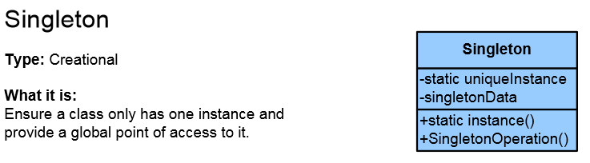
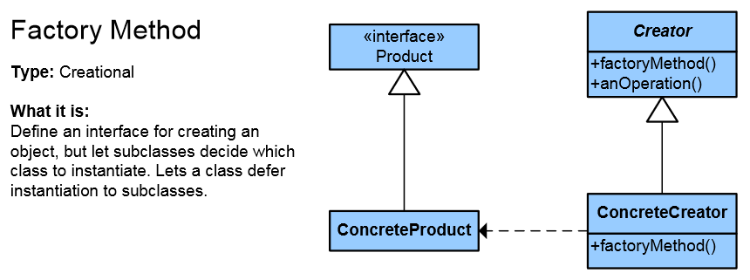
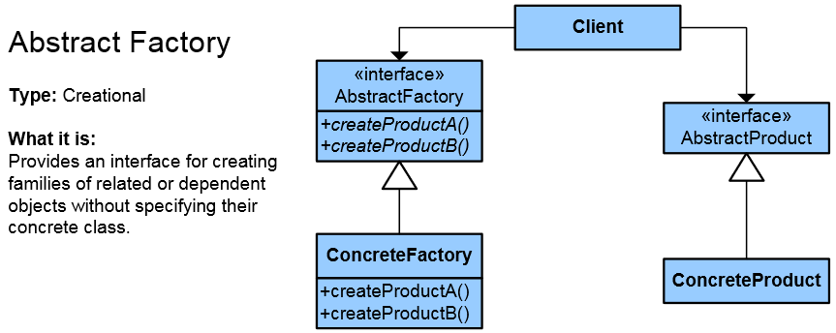
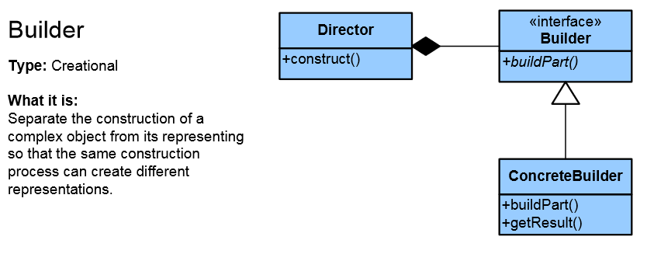
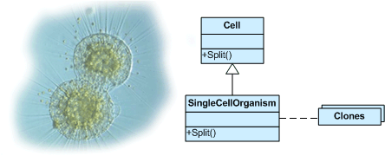
List of Creational Patterns
Singleton
Simple Factory
Factory Method
Abstract Factory
Builder
Prototype
Fluent Interface
Object Pool
Lazy initialization

Slide 9
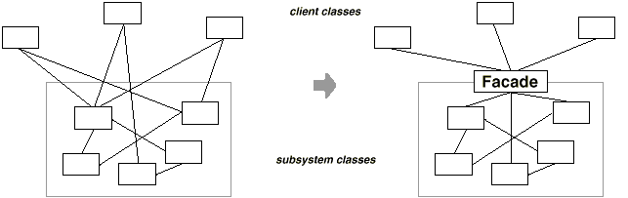
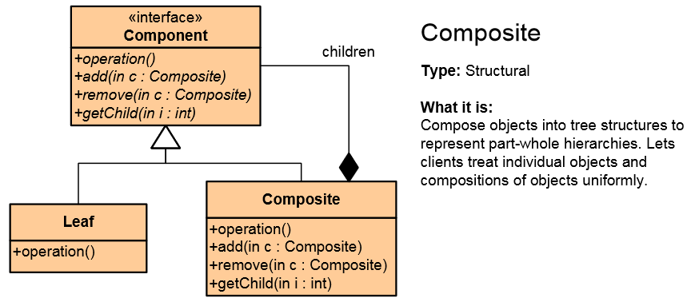
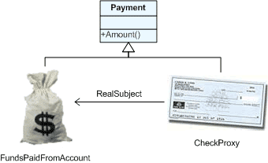
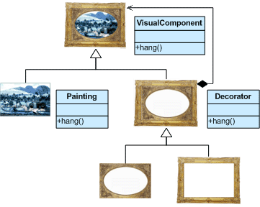
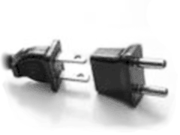
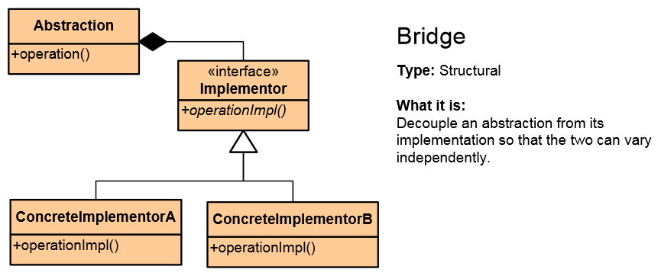

List of Structural Patterns
Façade
Composite
Flyweight
Proxy
Decorator
Adapter
Bridge

Slide 10
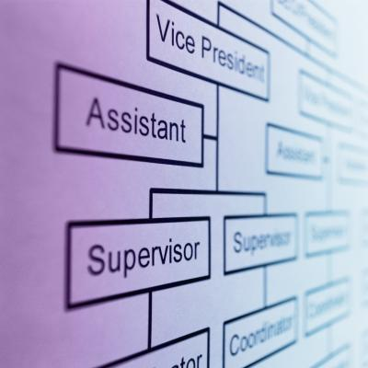
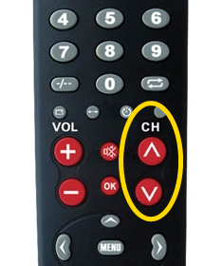
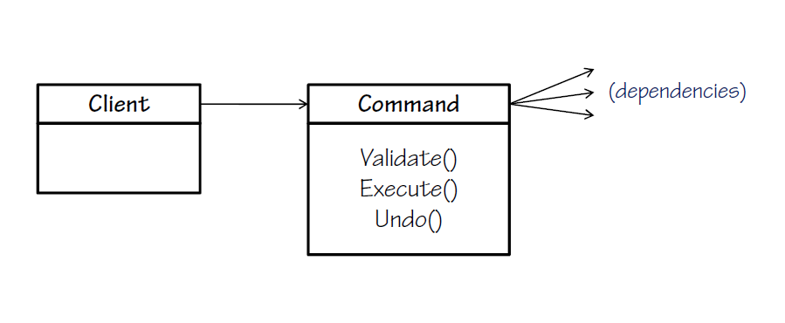
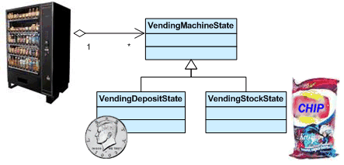
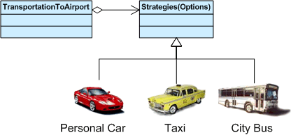
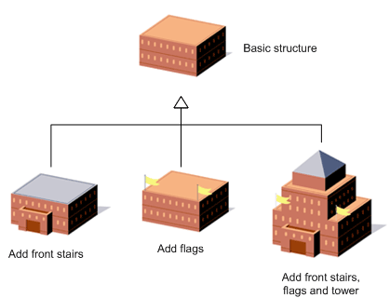
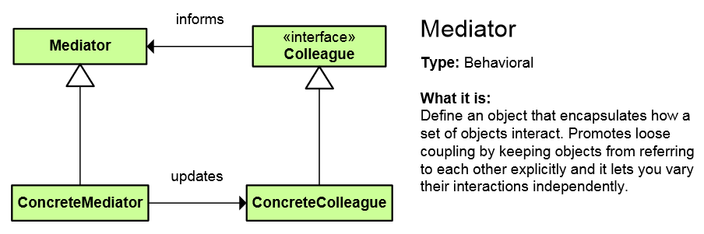
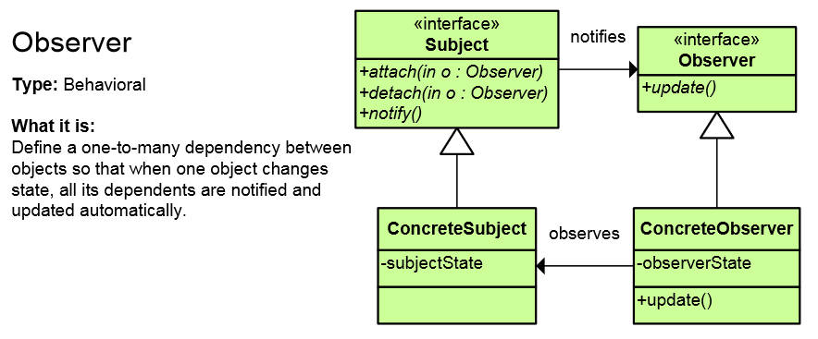
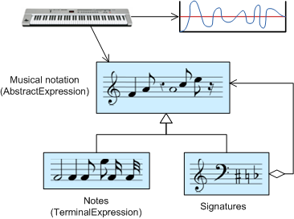
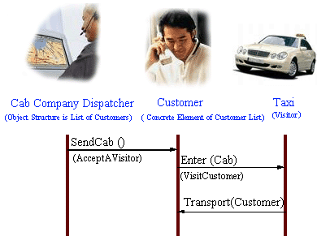
List of Behavioral Patterns
Chain of Responsibility
Iterator
Command
Template Method
Strategy
Observer
Mediator
Memento
State
Interpreter
Visitor

Slide 11
Concurrency patterns
Active Object
Double Checked Locking pattern
Monitor Object
An object to can be safely used by many threads
Read-Write Lock pattern
Thread Pool pattern
A number of threads are created to perform a number of tasks
And many more

Slide 12
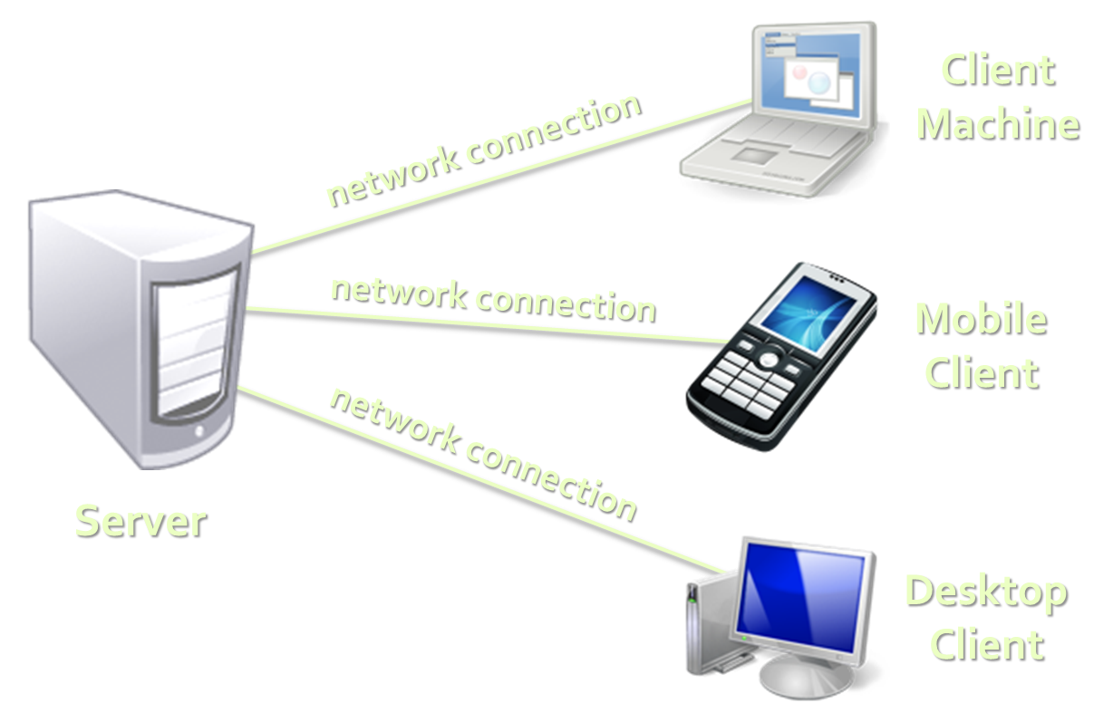
Architectural Patterns
Architectural patterns (systems design)
Client-Server Architecture
3-Tier Architecture
Client, Business and Data layers
Multi-Tier Architecture
MVC (Model-View-Controller)
MVP (Model-View-Presenter)
MVVM (Model-View-ViewModel)
SOA (Service-Oriented Architecture)
Using reusable building blocks

Slide 13
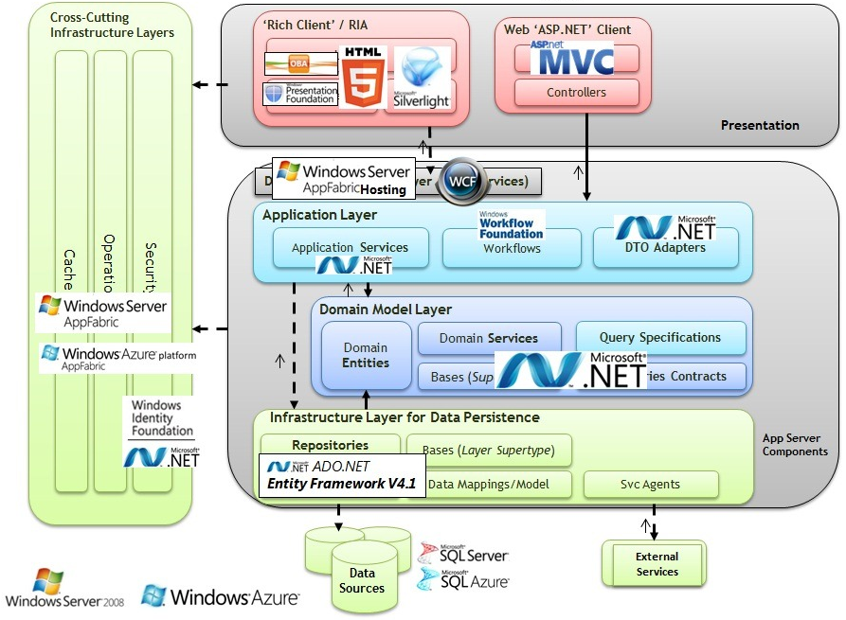
Multi-Tier Architecture

Slide 14
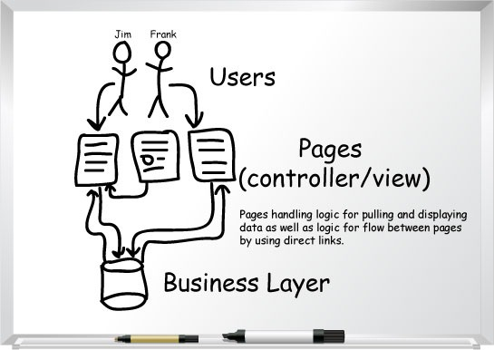
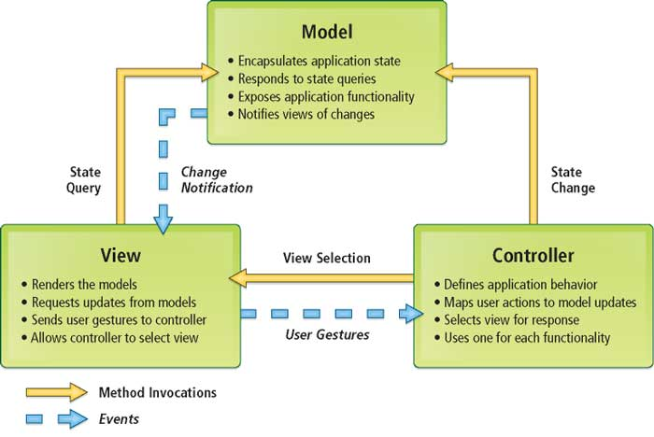
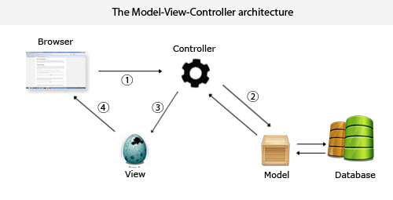
Model-View-Controller (MVC)

Slide 15
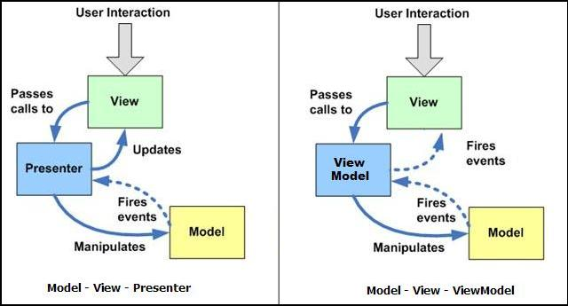
MVP vs. MVVM Patterns
MVVM is like MVP but leverages the platform's build-in bi-directional data binding mechanisms

Slide 16

SOLID and Other Principles
SOLID Principles
SRP – Single Responsibility Principle
OCP – Open/Closed Principle
LSP – Liskov Substitution Principle
ISP – Interface Segregation Principle
DIP – Dependency Inversion Principle
DRY – Don't Repeat Yourself
YAGNI – You Aren't Gonna Need It
KISS – Keep It Simple, Stupid

Slide 17
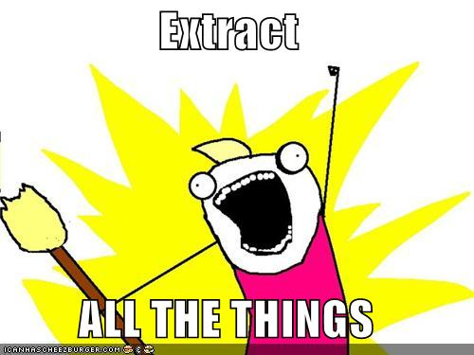
SRP
"The Single Responsibility Principle states that every object should have a single responsibility, and that responsibility should be entirely encapsulated by the class."
Wikipedia
"There should never be more than one reason for a class to change."
Robert C. “Uncle Bob” Martin

Slide 18
OCP
"The Open / Closed Principle states that software entities (classes, modules, functions, etc.) should be open for extension, but closed for modification."
Wikipedia
Open to Extension
New behavior can be added in the future
Closed to Modification
Changes to source or binary code are not required

Slide 19
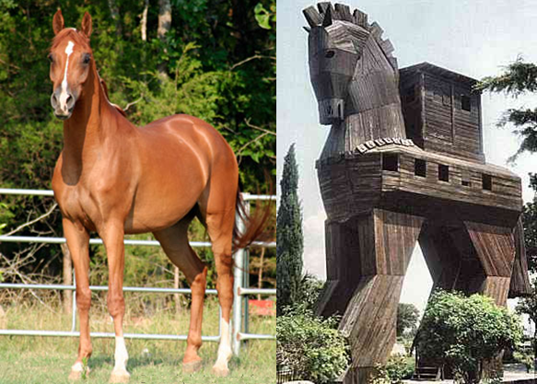
LSP
"The Liskov Substitution Principle states that Subtypes must be substitutable for their base types."
Agile Principles, Patterns, and Practices in C#
Substitutability – child classes must not
Remove base class behavior
Violate base class invariants

Slide 20

ISP
"The Interface Segregation Principle states that Clients should not be forced to depend on methods they do not use."
Agile Principles, Patterns, and Practices in C#
Prefer small, cohesive interfaces
Divide "fat" interfaces into smaller ones

Slide 21
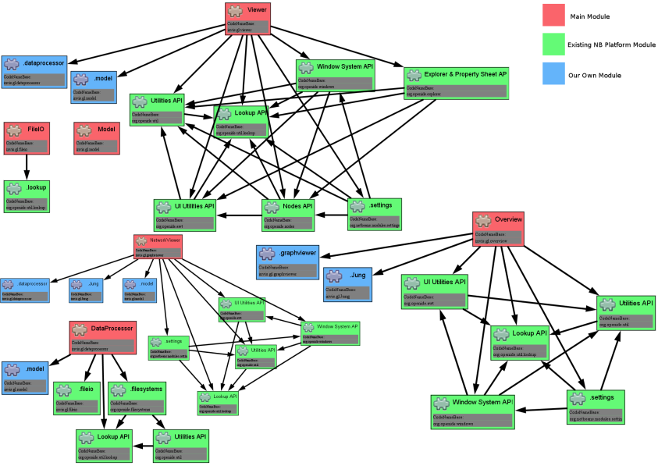
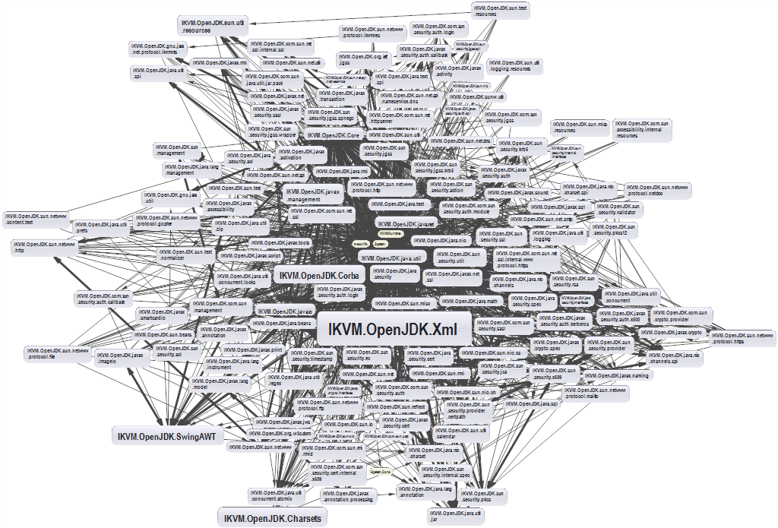
DIP
"High-level modules should not depend on low-level modules. Both should depend on abstractions."
"Abstractions should not depend on details. Details should depend on abstractions."
Agile Principles, Patterns, and Practices in C#

Slide 22

DRY
"Every piece of knowledge must have a single, unambiguous representation in the system."
The Pragmatic Programmer
"Repetition in logic calls for abstraction. Repetition in process calls for automation."
97 Things Every Programmer Should Know
Variations include:
Once and Only Once
Duplication Is Evil (DIE)

Slide 23

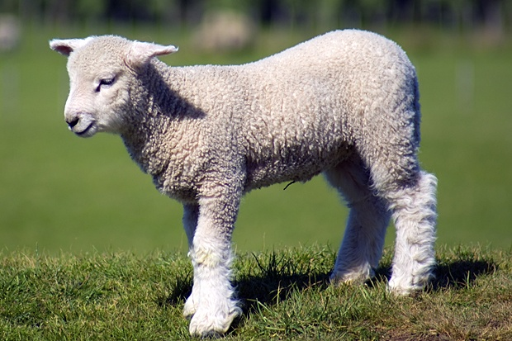
YAGNI
"A programmer should not add functionality until deemed necessary."
Wikipedia
"Always implement things when you actually need them, never when you just foresee that you need them."
Ron Jeffries, XP co-founder

Slide 24
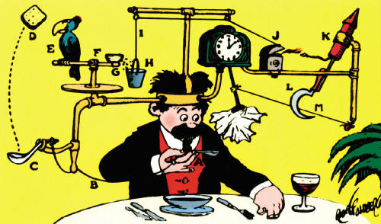

KISS
"Most systems work best if they are kept simple."
U.S. Navy
"Simplicity should be a key goal in design and unnecessary complexity should be avoided."
Wikipedia

Slide 25
Introduction to Design Patterns
http://academy.telerik.com

